Slide 1
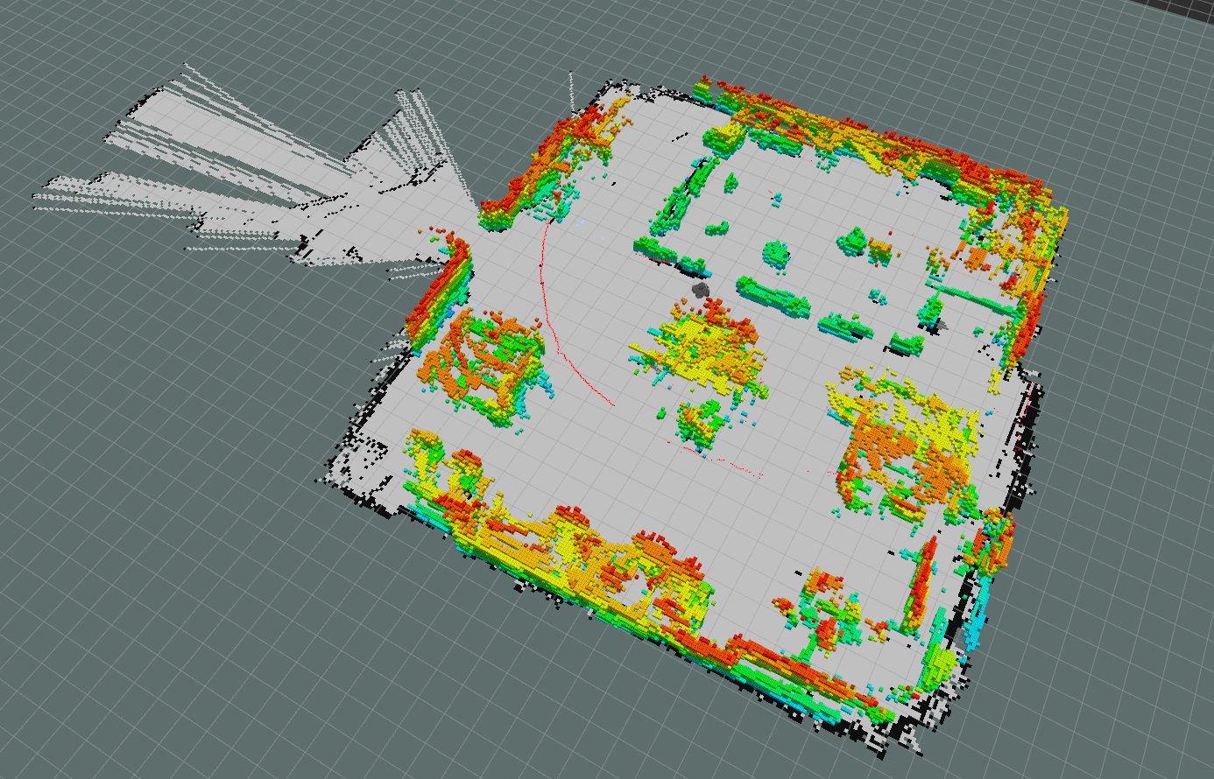
Project #3

Slide 2
Project #3
Map: Robotics Realization Lab’s map
Search Algorithm: A*
Vehicle: Deferential drive robot with two wheels
The diameter of the robot: 400mm (just like turtlebot2)
Software: V-rep or Gazebo
Deliverables:
Source code
Simulation results
Text file with right wheel and left wheel rotational velocity in each line (2 Hz)
Readme file
Due date: April 8

Slide 3
Rubric
1- Implementing A* for project 2 (source code) : 2 points
2- Implementing A* for differential drive vehicle (source code with proper commenting): 5 points
3- Left wheel’s and right wheel’s rotational velocity in a txt file: 3 Points
4- Readme.txt file with instruction : 1 point
5- Implementation on real robot (Turtlebot): 4 points
Note: Students who prefer to implement project 4 on real robot (Baxter) can ignore step 5

